Slide 1











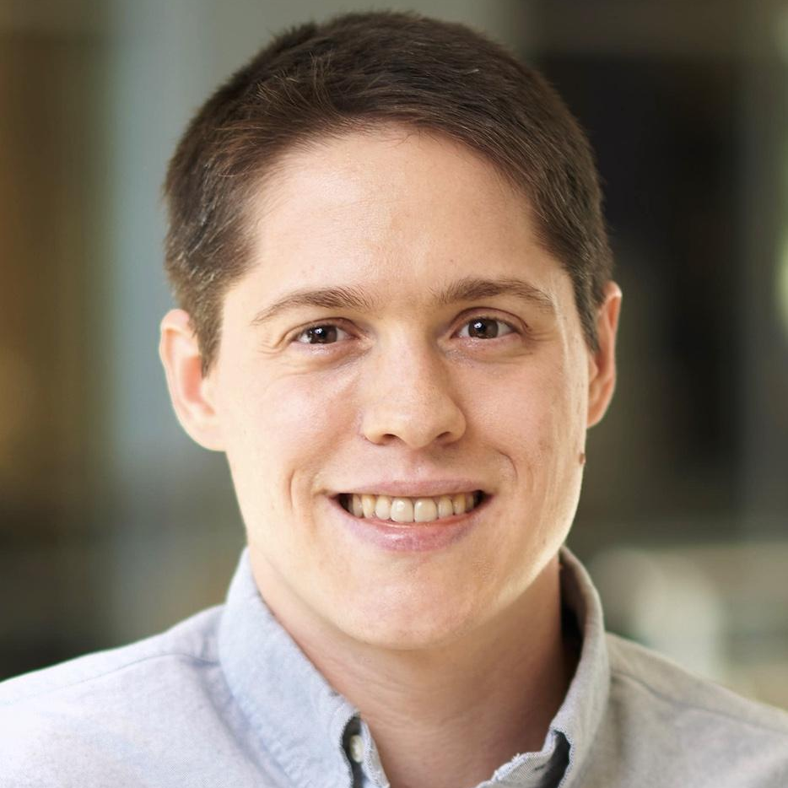







PeaTMOSS: A Dataset and Initial Analysis of Pre-Trained Models in Open-Source Software
Wenxin Jiang
Jerin Yasmin
Jason Jones
Nicholas Synovic
Nathaniel Bielanski
Jiashen Kuo
Yuan Tian
George K. Thiruvathukal
James C.
Davis
Notes:
Hi my name is Wenxin Jiang from Purdue University
Today I will present our MSR paper: “PeaTMOSS: A Dataset and Initial Analysis of Pre-Trained Models in Open-Source Software”.

Slide 2
Contributions
A SQL database including 281K PTM packages and 28K downstream GitHub applications.
Extract unstructured metadata by a LLM-based tool
Provide the initial measurement of PTM supply chain
Assess PTM license compatibility with downstream GitHub applications

Slide 3
Background and Motivation

Slide 4

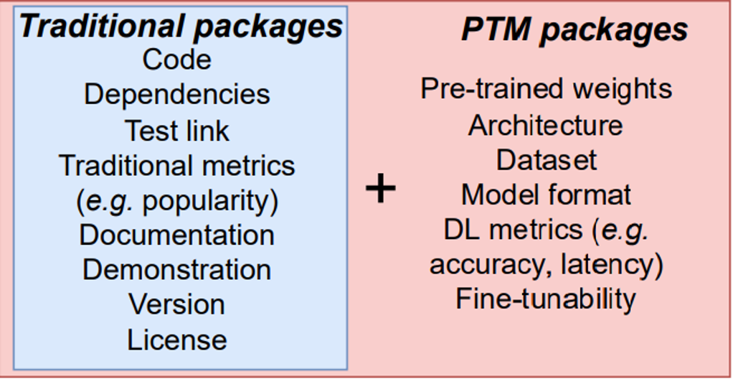




Pre-Trained Model (PTM) Package
PTM =
[1] Jiang, Wenxin, et al. "An empirical study of pre-trained model reuse in the hugging face deep learning model registry." 2023 IEEE/ACM 45th International Conference on Software Engineering (ICSE). IEEE, 2023.
Notes:
PTM definition
Model hubs which host these expensive artifacts
PTM package = traditional parts +
Model reuse:
Direct deployment (out-of-the-box)
Model fine-tuning
Dataset generation
…

Slide 5
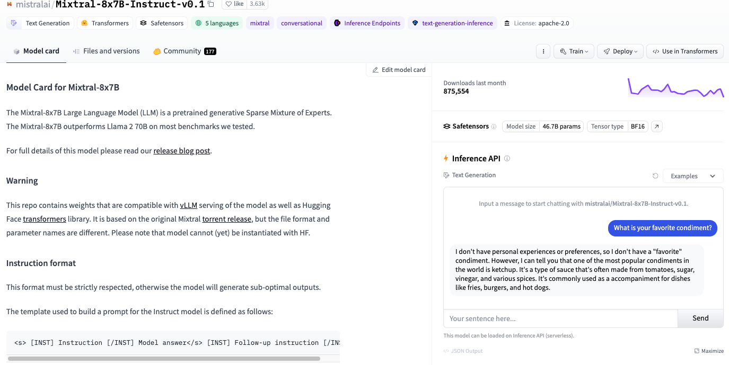
Pre-Trained Model (PTM) Package

Slide 6

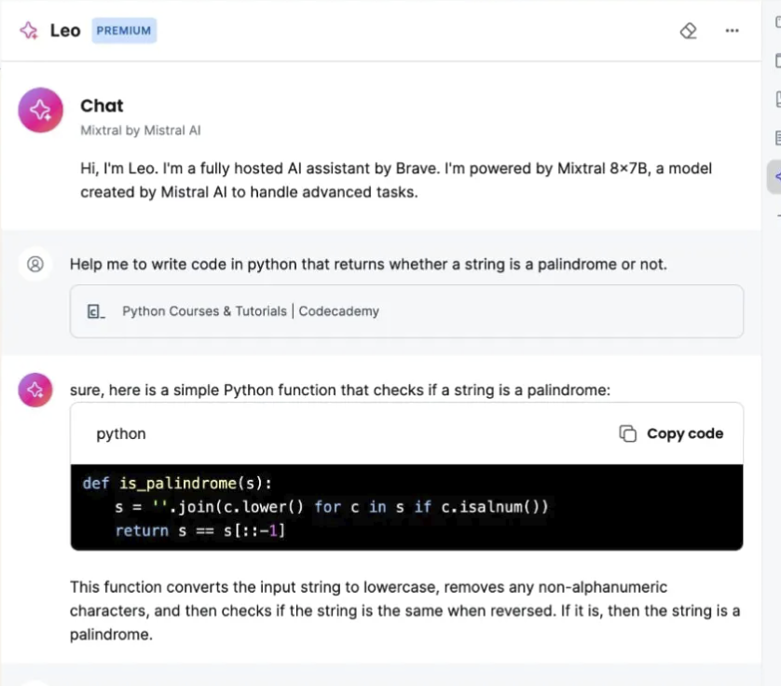
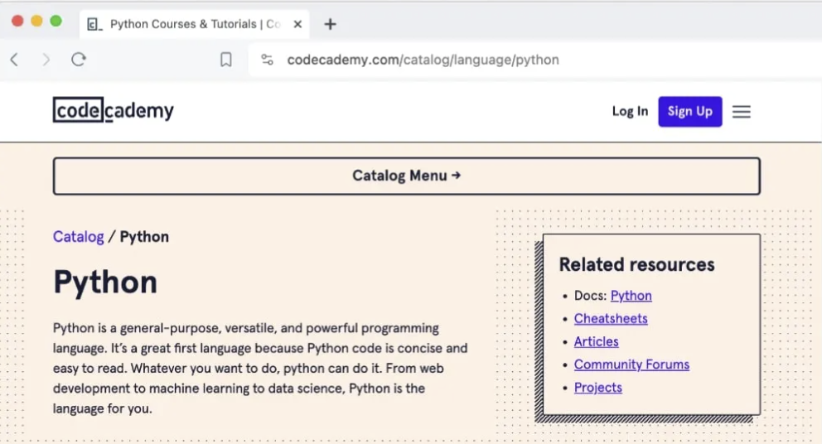
Example Usage of PTM Package
Leo (AI Assistant)
Notes:
Brave: one of the most popular free and open-source web browser
* *
Brave integrated an AI chat assistant named Leo which is a relatively new feature.
Leo is built right into the browser, and it can help the users answer questions, summarize pages, generate contents.

Slide 7

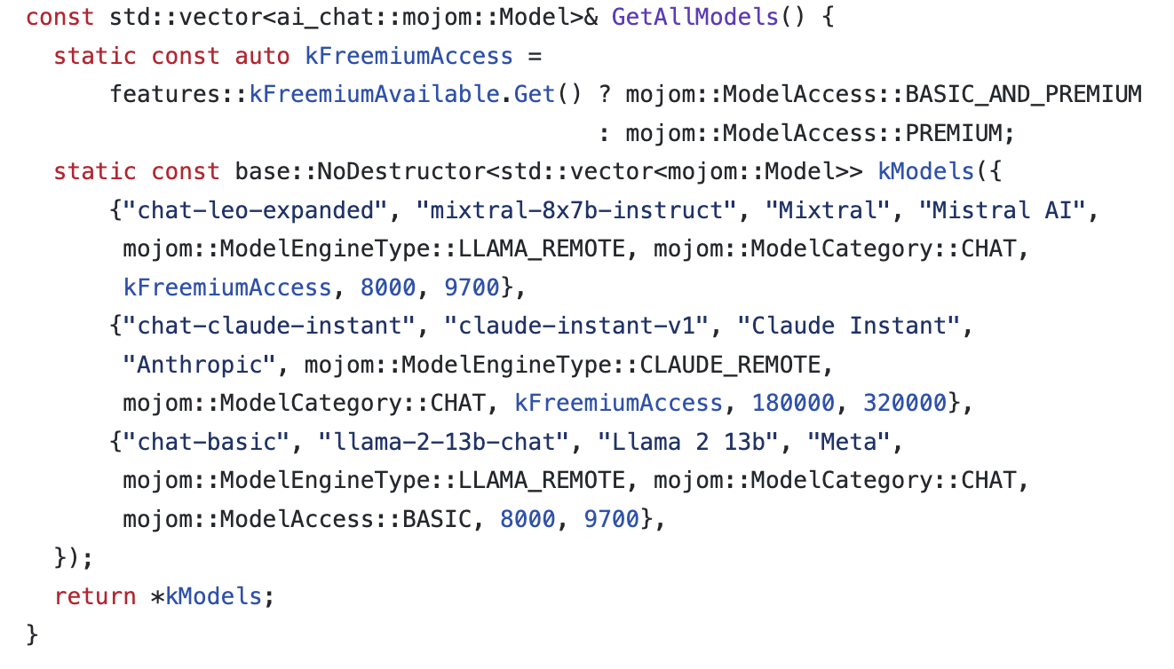

Example Usage of PTM Package
Notes:
This is a source code snippet of brave browser.
* *
Brave uses Mixtral and Llama2 out-of-box with some prompt engineering.

Slide 8
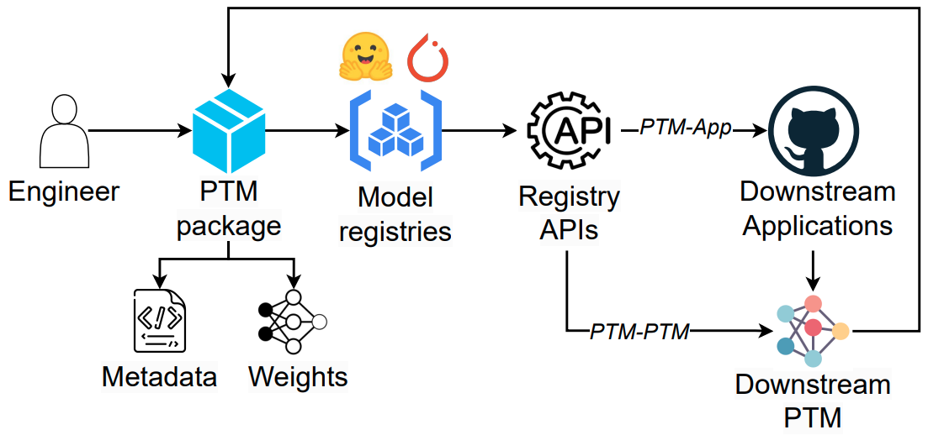
PTM Supply Chain
Popularity keeps increasing!
Time
# Packages
# Downloads (top 10%)
Aug. 2022
124 K
269 Million
Aug. 2023
282 K
587 Million
Notes:
PTM supply chain
*
Popularity
2022 -> 2023

Slide 9
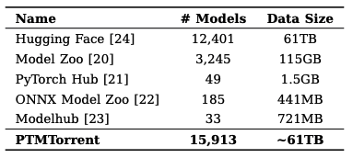
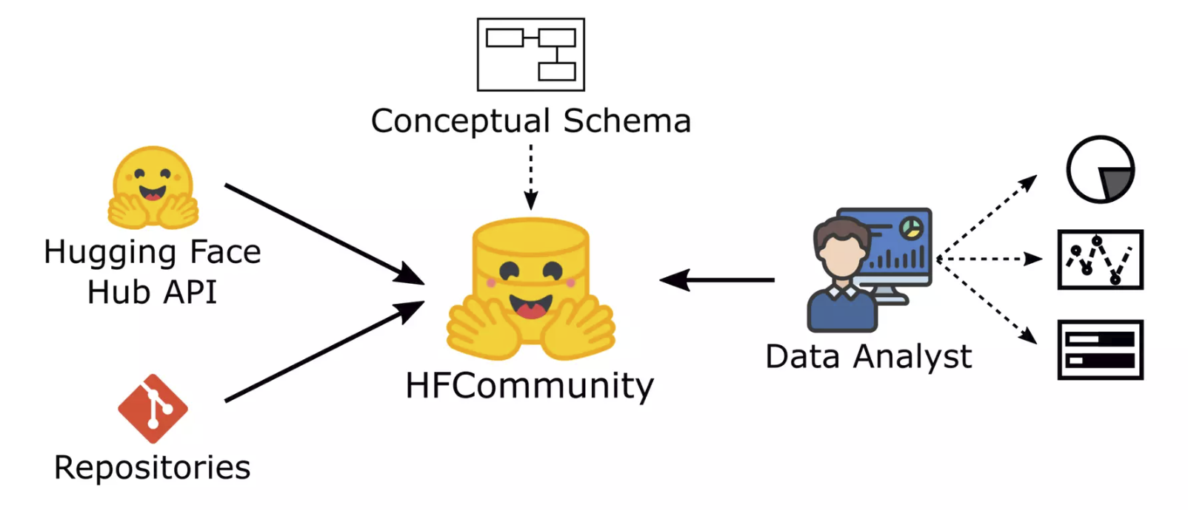
Existing Datasets
PTMTorrent
[Jiang et al. MSR’23]
HFCommunity
[Ait et al. SANER’23]
Gaps:
Lack of queryable/standardized PTM metadata across multiple hubs.
The downstream applications (GitHub) of PTM supply chain was missing in the existing datasets.
Lack of measurements on PTM supply chain.
Notes:
PTMTorrent: 5 model hubs
*
HFCommunity: HF and relevant github repos
*
Gaps

Slide 10
PeaTMOSS Dataset

Slide 11
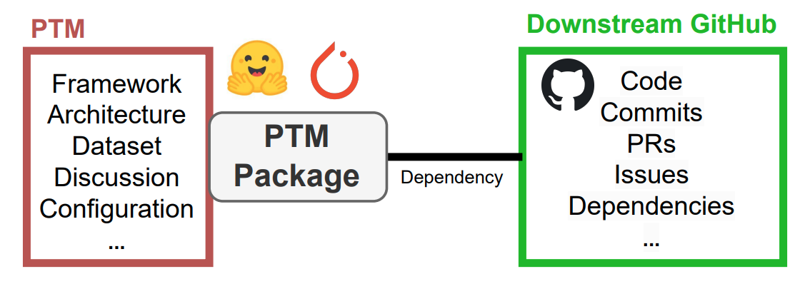
Pre-Trained Models in Open-Source Software
The PeaTMOSS dataset
“Lite”: 8 GB (metadata only)
“Full” : 48 TB including model weights and history

Slide 12
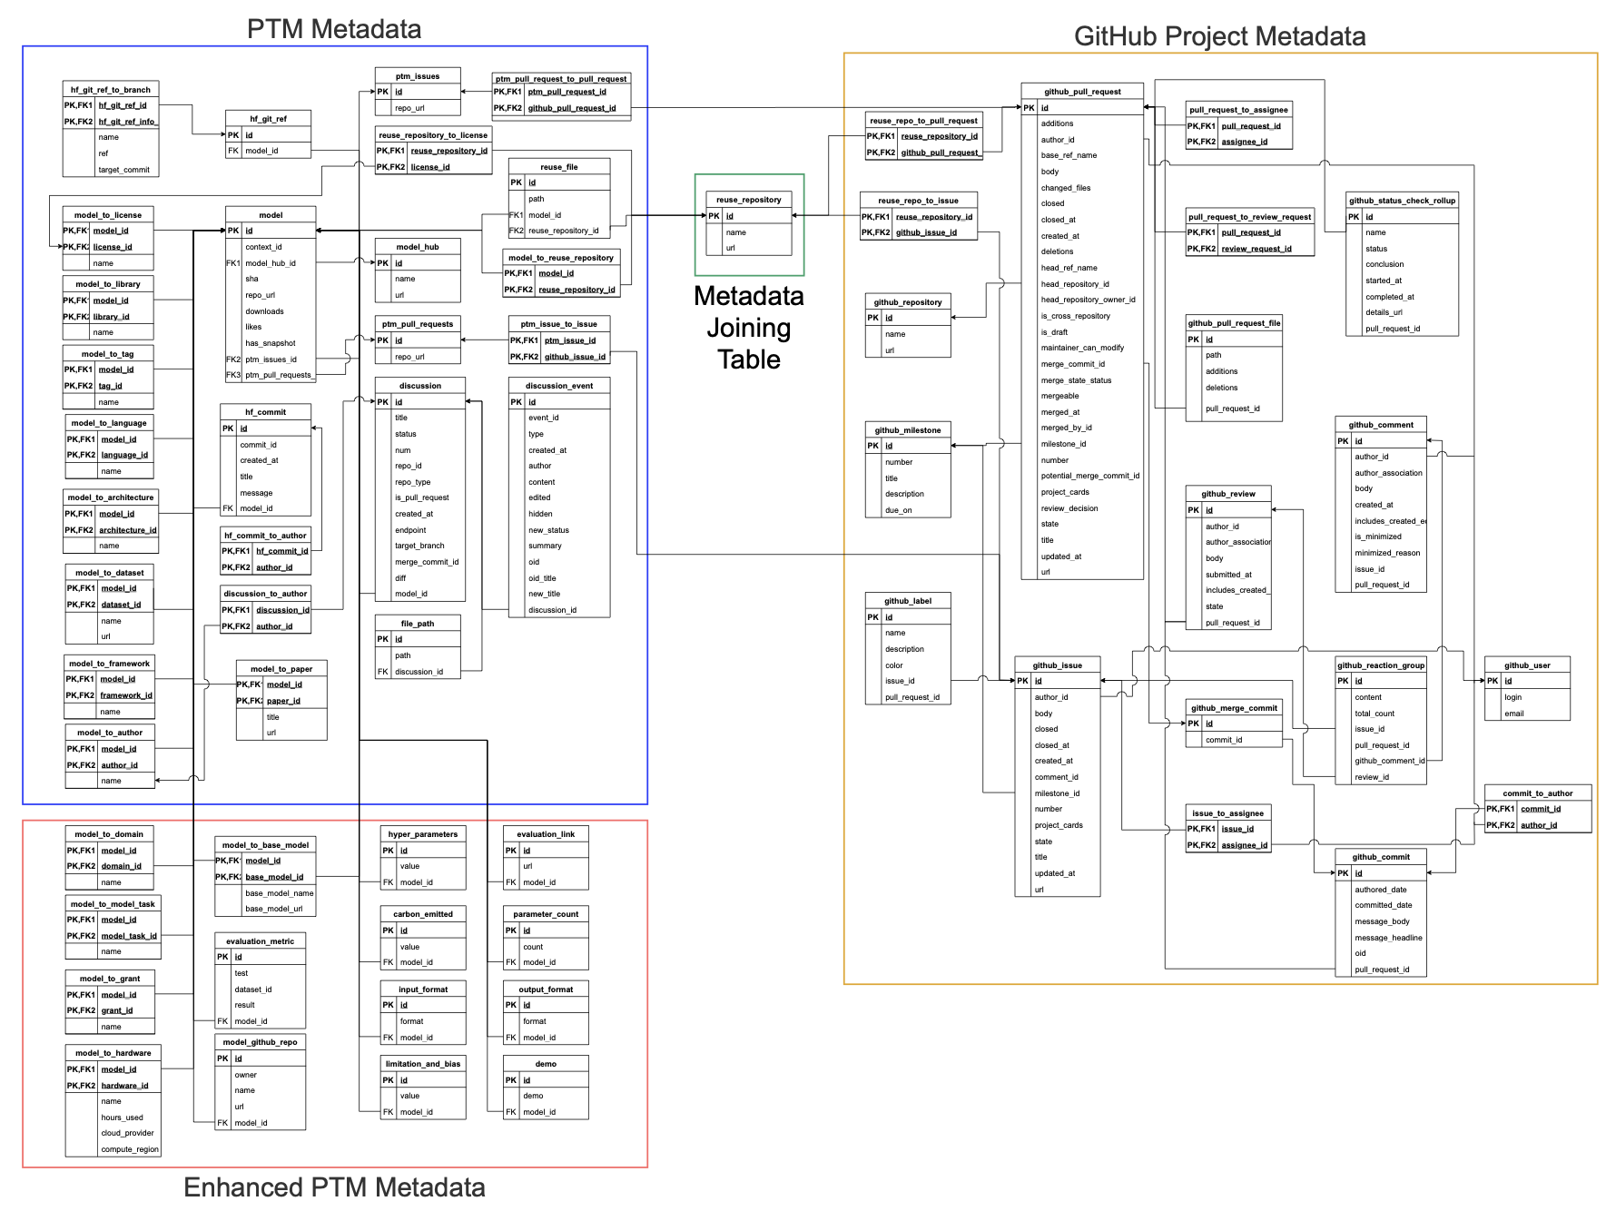
DB Schema - Overview
PTM Metadata
GitHub Application Metadata
Enhanced PTM Metadata
Mapping table
Notes:
Here is the overview of our database schema.
PTM Metadata, Mapping table connecting the upstream PTM package to downstream GitHub Applications, GitHub Application metadata, Enhanced PTM metadata.
I understand that this is hard to read… Let me give you more details.

Slide 13
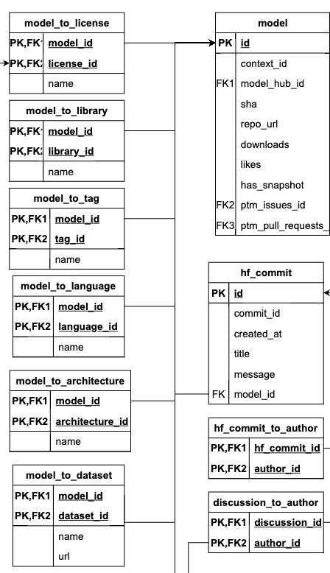
DB Schema – Basic PTM Metadata
Example metadata:
Downloads
Commits
Authors
License
Library
Model tag
Language
Architecture
Dataset
…

Slide 14
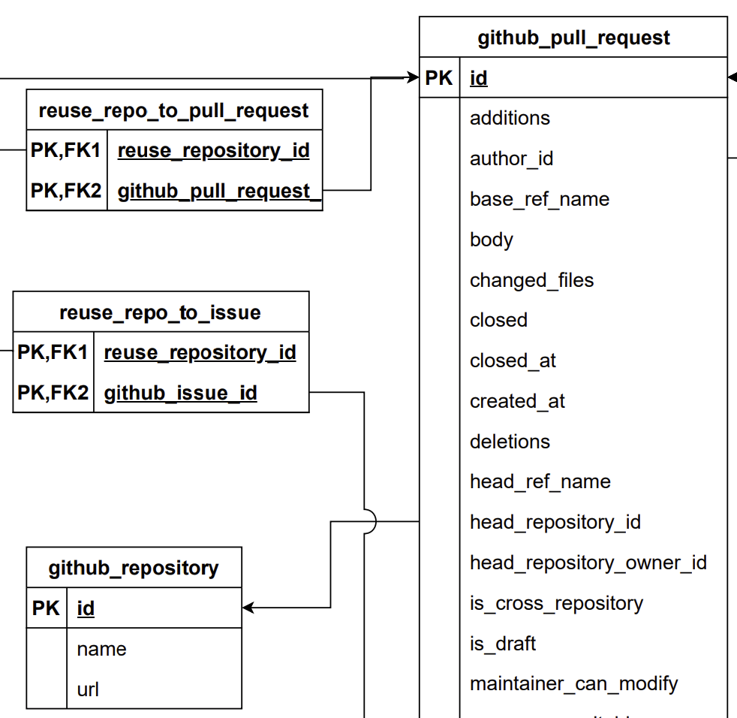
DB Schema - GitHub Project Metadata
Example metadata:
PRs
Issues
Commits
Label
License
…
Notes:
We have detailed information of PRs, issues, commits. For example, for each PR, our database include all text data, timeline, file changes, etc.

Slide 15
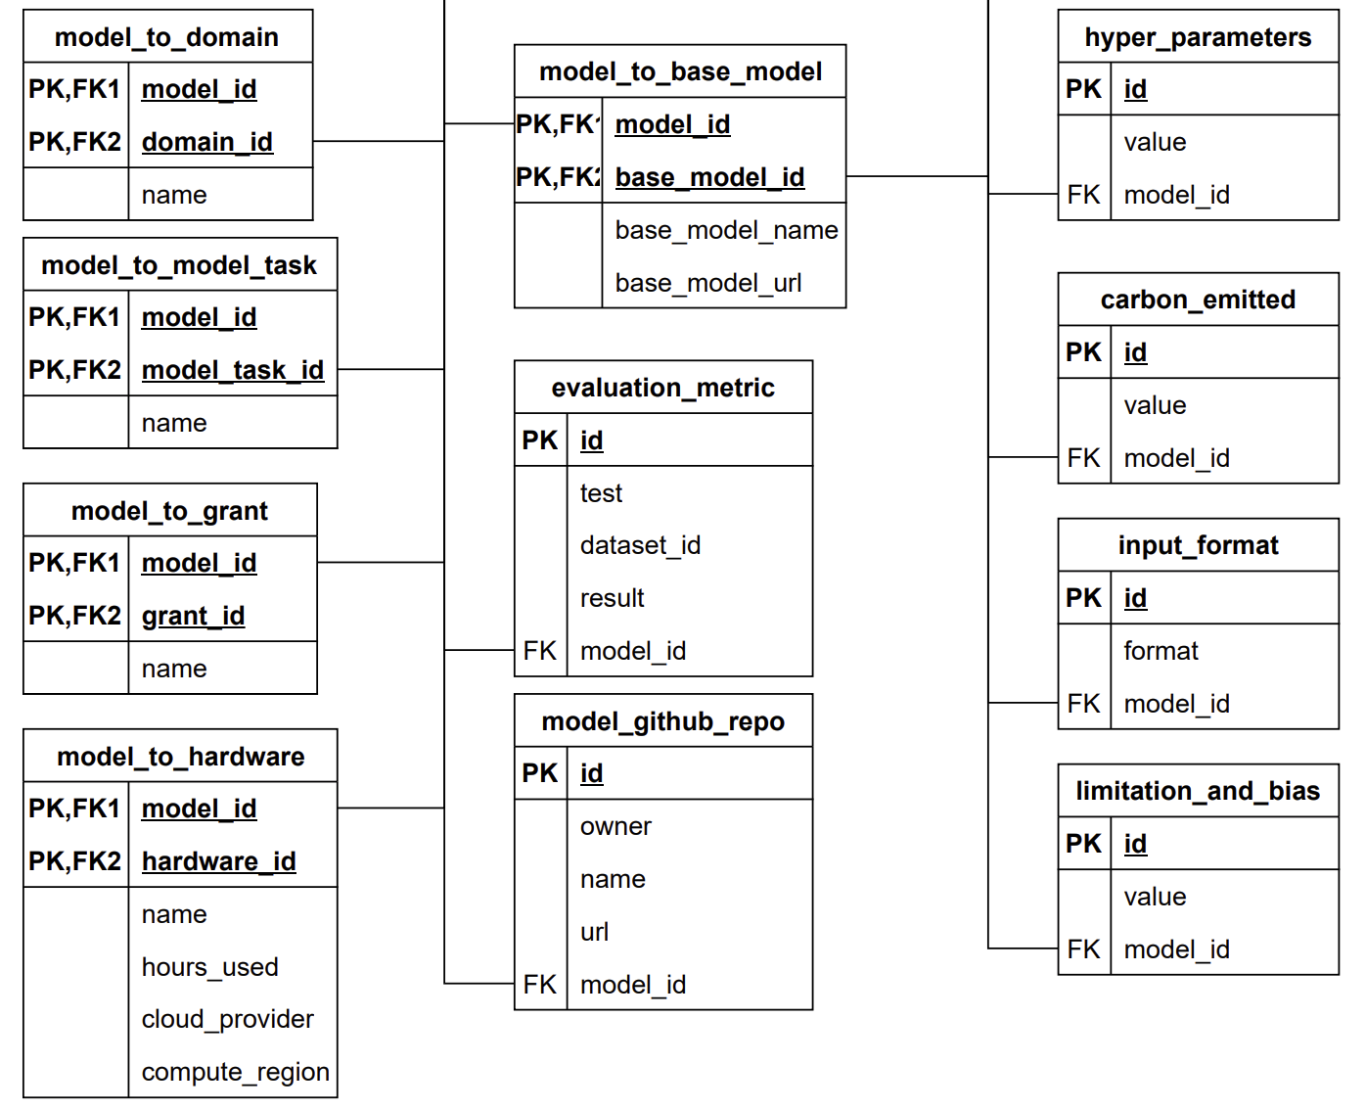
DB Schema - Enhanced PTM Metadata
Unstructured Model card
GPT-4-turbo
Structured data
Example metadata:
Base/upstream model
Hyper parameters
Carbon emitted
Evaluation metrics
Hardware requirements
Parameter count
…
Notes:
Depending on the model card, not all these information are present
We use a standardized schema so all the data are queryable for further analysis.

Slide 16
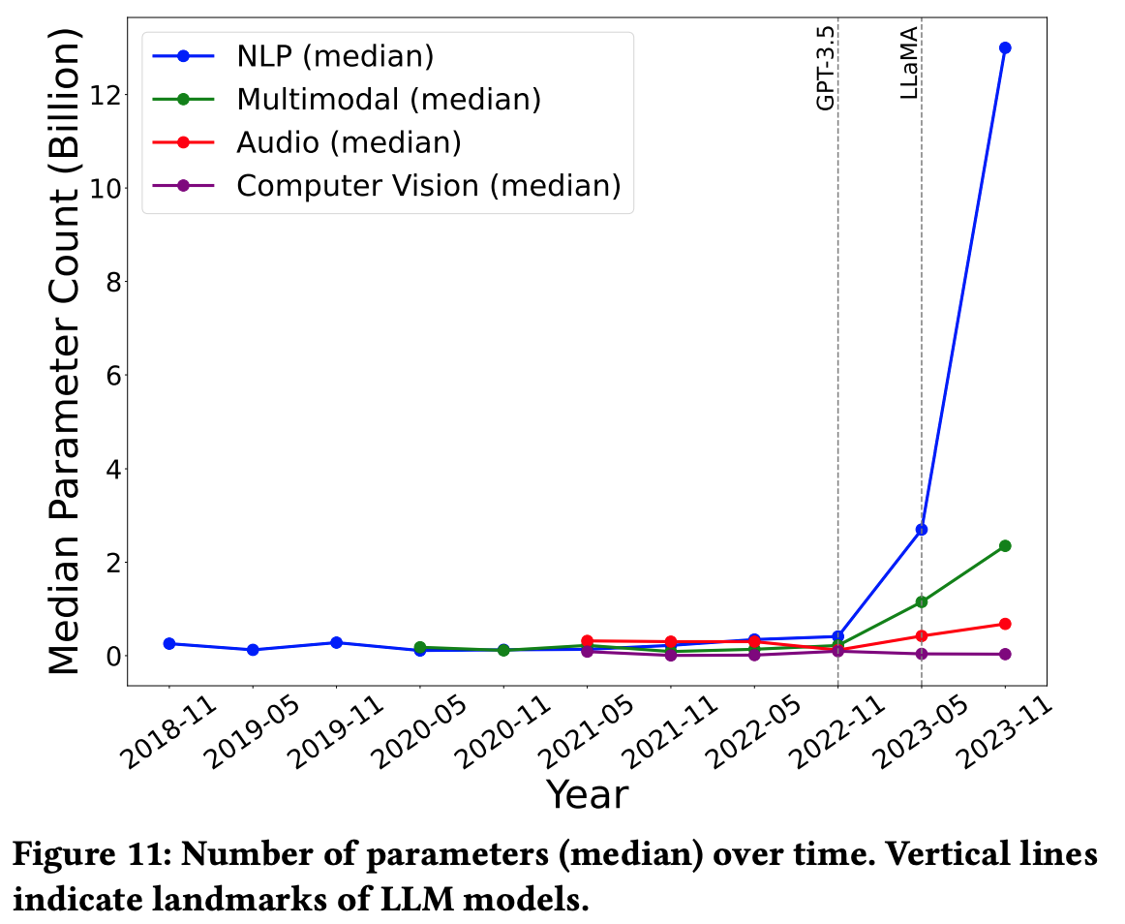
Example Measurement of PTM Supply Chain
NLP and multimodal: noticeably increased after November 2022
Audio and CV: stable
More measurements can be found in our paper!
Notes:
Figure 11 tracks the median model size (i.e., parameter count) by different domain. There is a marked increase in the median size of NLP and multimodal PTMs, especially noticeable after March 2023. Meanwhile, the median parameter count for Audio and CV models has remained relatively stable.

Slide 17
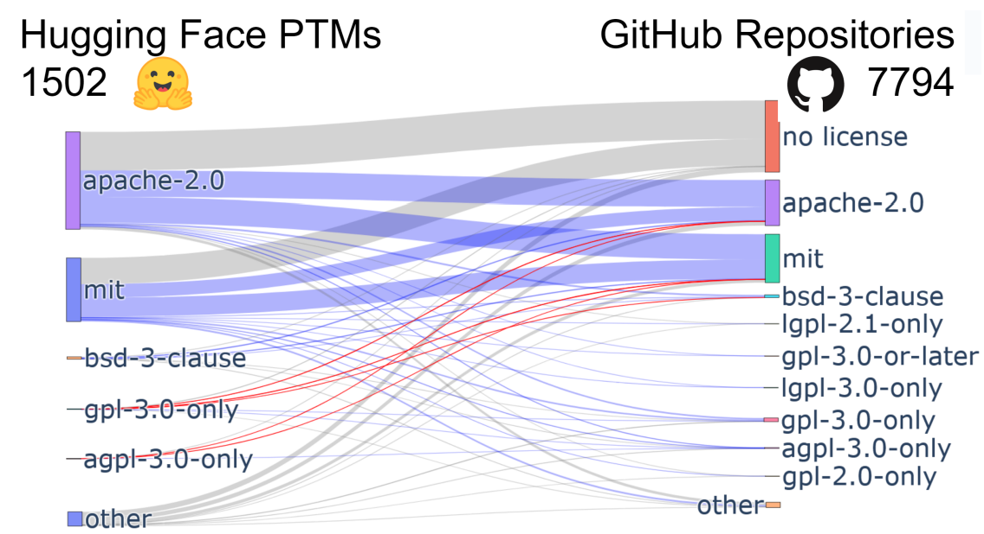
Mining PTM-Application License Compatibility
Excluded
Compatible
Incompatible
Identical: 25.61%
Incompatible: 0.24%
Notes:
Source: Linux Foundation’s OSS license compatibility table
Grey: not included in Linux table
Blue: compatible
Red: incompatible
In 25.61% cases, PTM-App licenses are identical
In 0.24% cases, the licenses are incompatible, where there is copyleft provisions in the PTM’s license that are not honored by the Application
Many downstream GitHub repositories (43.42%) choose not to define a license (“no license” in the figure), instead operating under the default posture of Hugging Face (full reuse [48]) and GitHub (much stricter — copyright reserved to author [40]). In 25.61% of cases, the PTM-Application licenses are identical. 0.24%: this is the result of copyleft provisions in the PTM’s license that are not honored by the Application

Slide 18
Future Directions
Notes:
Example lines of research for researchers to investigate, phrased as research questions. These questions are divided into three groups. The first group uses the Pre-Trained Model portion of the dataset (PTM). The second group of questions makes use of the GitHub portion of the dataset (GH). The third group asks questions that require Integrating both parts of the dataset (I).

Slide 19
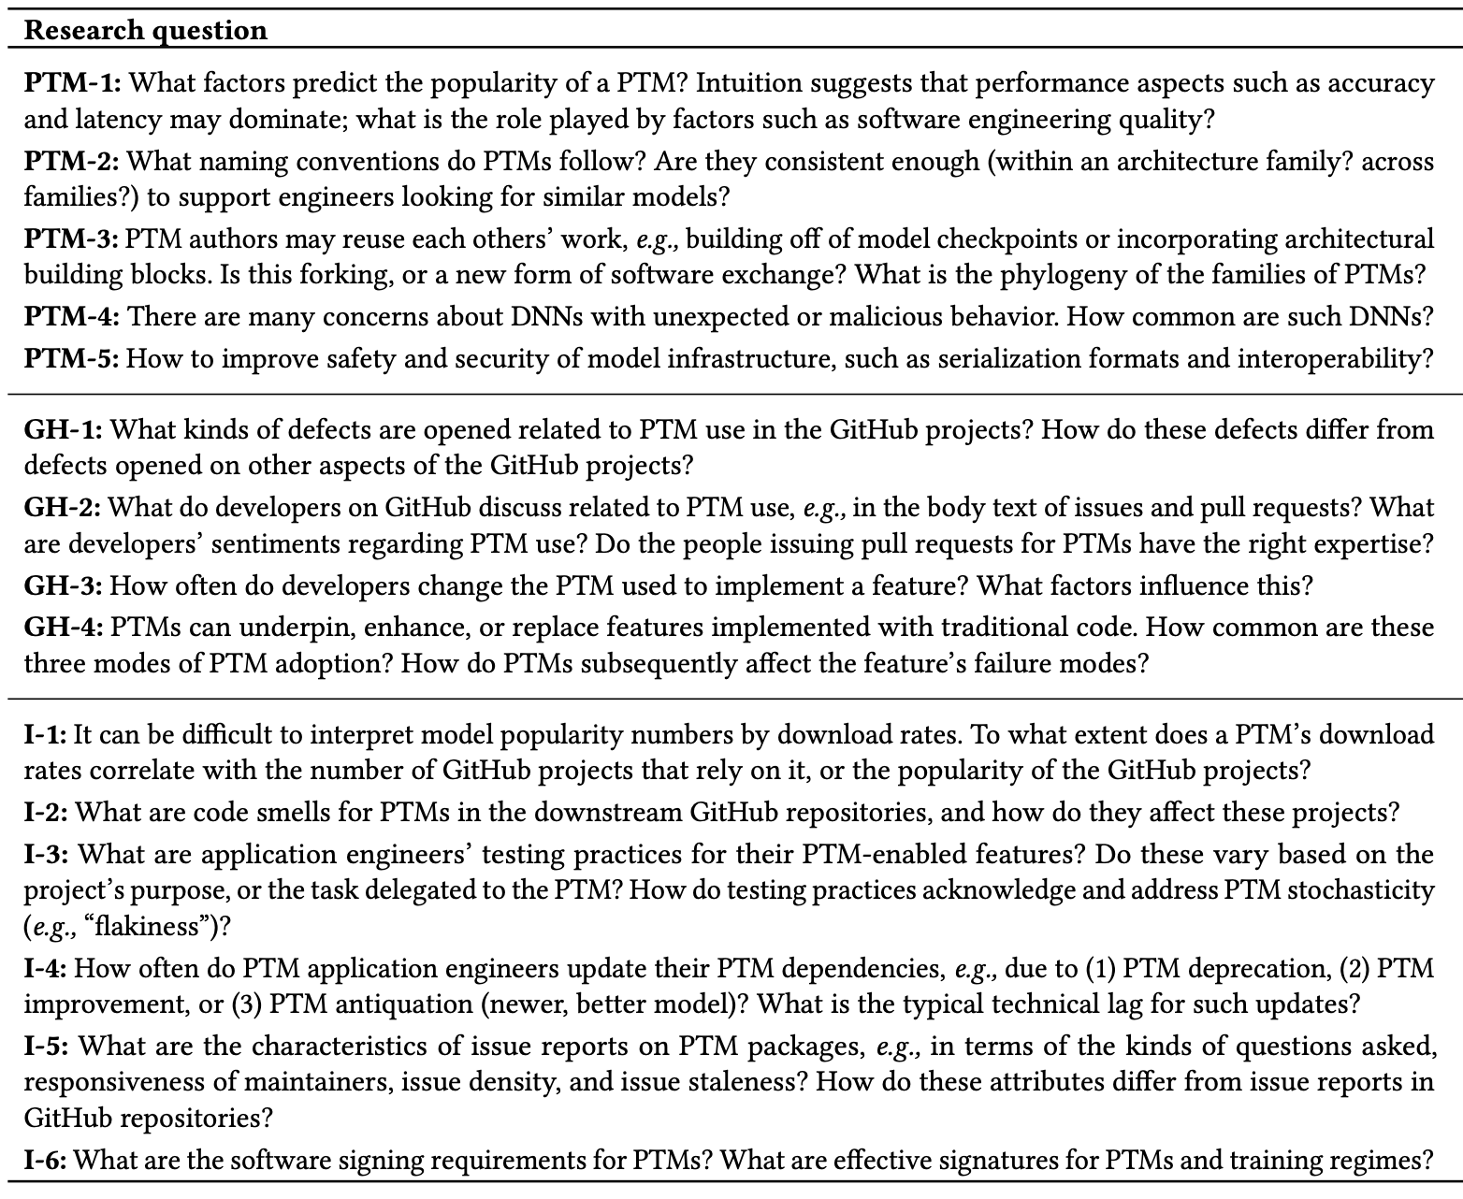
Future Direction on PTM - Overview
We proposed 15 future directions in the paper:
PTM
GitHub
Integration

Slide 20
Future Direction on PTM - Examples
Factors of PTM popularity and quality
PTM naming conventions
PTM
Evolution of PTM features
PTM reuse patterns
GitHub
Testing practices for PTM features
PTM Recommendation
Integration

Slide 21



Summary
PTM reuse is an emerging and novel form of software reuse
We have only scratched the surface of PTM reuse
Let’s research more on PTM packages!
arxiv.org/2402.00699
Contact: jiang784@purdue.edu
Website: wenxin-jiang.github.io
https://github.com/PurdueDualityLab/PeaTMOSS-Artifact
Notes:
To summarize
We must ensure its utility (for efficient software engineering), and its security (for everyone)
Let’s research more on PTM packages!
Here are my contact information and our artifact. Thanks for your attention!
That's all for my talk!

Slide 22
Bonus Slides

Slide 23
Motivations
Lack of queryable/standardized PTM metadata.
The downstream part (GitHub) of PTM supply chain was missing in the existing datasets.
Lack of statistical analysis on PTM supply chain.

Slide 24
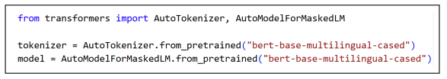
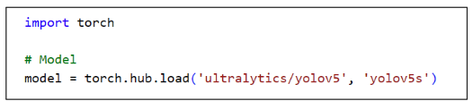

Example Usage of PTM Package
Reuse Cases:
Direct deployment
Model fine-tuning
Dataset generation
…
Notes:
Model reuse:
Direct deployment (out-of-the-box)
Model fine-tuning
Dataset generation
…

Slide 25
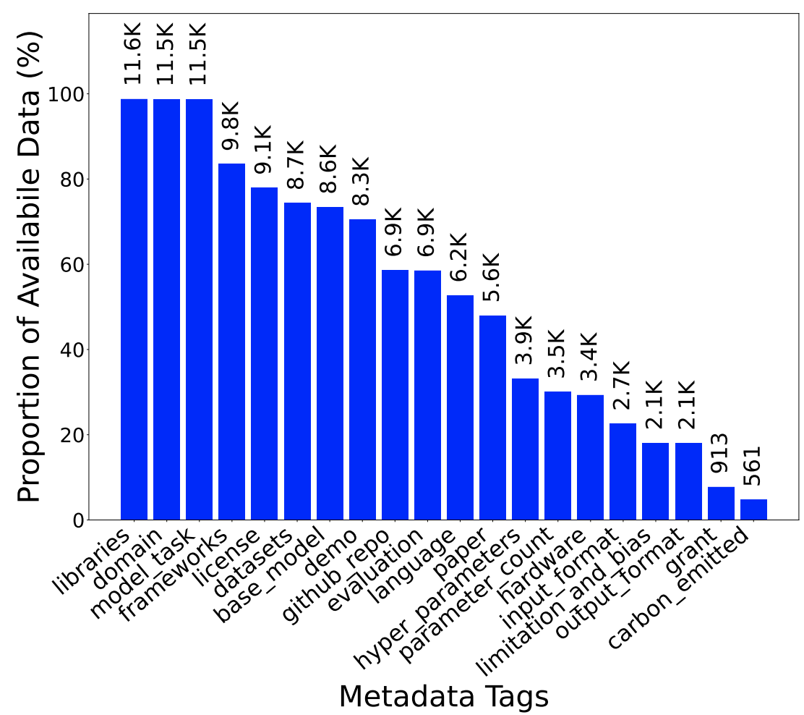
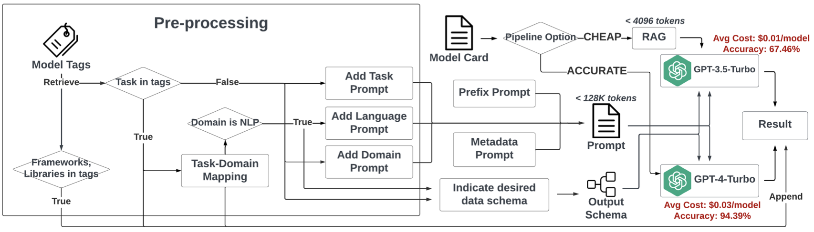
Automated standardization of data from model cards
Notes:
To get these attributes, we mined model cards. We used NLP, specifically LLMs because they work great for this kind of thing. We evaluated two approaches, a “cheap” (GPT 3.5-turbo) and an “accurate” (GPT 4). The prompts used depend the type of model. Then these prompts are applied to the model card. The cost-optimized “cheap” pipeline differs primarily by incorporating the Retrieval-Augmented Generation (RAG) framework [63] to reduce token count.
This approach – mining model cards rather than measuring models directly – means we lack information for many models. What we can extract depends on what is reported. This figure shows what we can get this way.
*
The proportion of available metadata for each category from Hugging Face model cards. Data is reported for the 11,975 models available at measurement time (Nov. 2023). About 17% of the sample (2,321 models) became unavailable between project initiation and this measurement

Slide 26
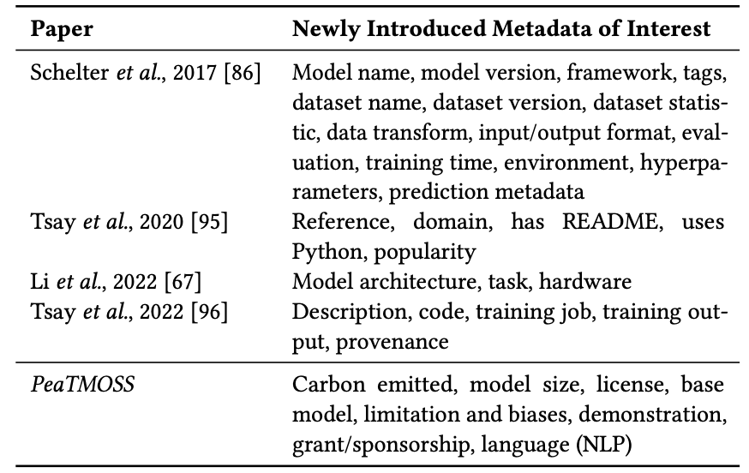
Attributes Captured
Notes:
A list of PTM metadata mapped to the first paper that men- tioned it. PeaTMOSS includes these fields plus more (last row of table). Our artifact shows the mapping of these fields to our schema.

Slide 27
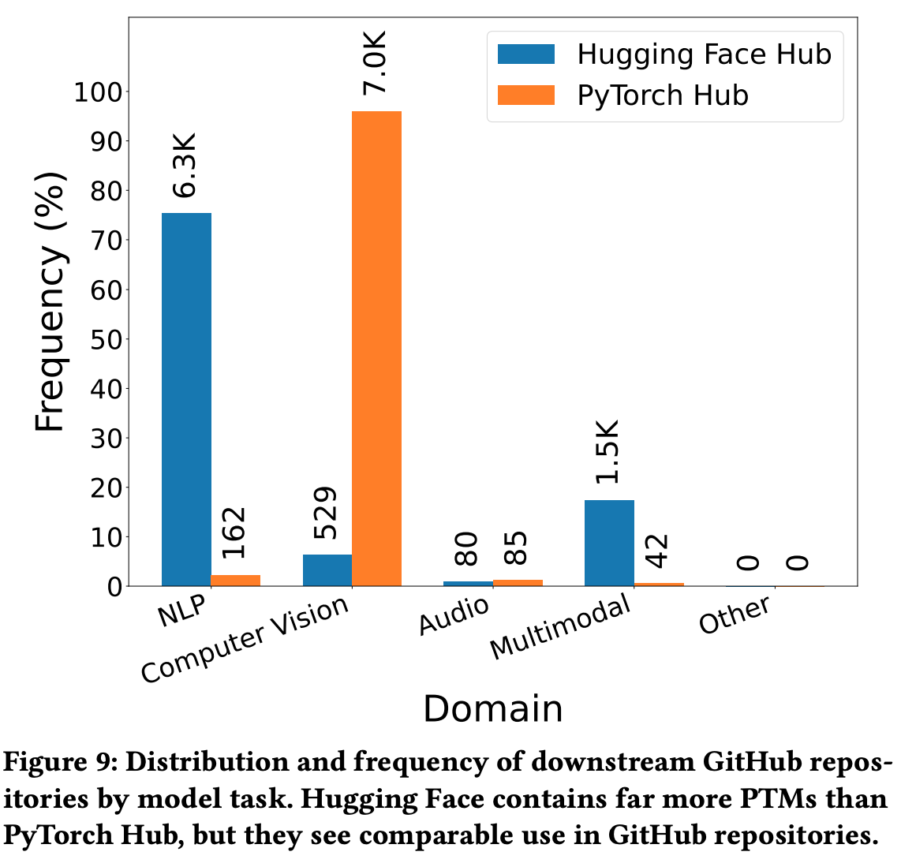
Statistics of PTM Supply Chain by Domains
Dominant PTM domains:
Hugging Face:
NLP: 60.3%
Pytorch Hub:
CV: 56.1%
Audio: 27.6%
Notes:
Figure 8 presents the distribution of models across various problem domains in both Hugging Face and PyTorch Hub. It reveals that NLP models are predominant on Hugging Face (60.3%), whereas PyTorch Hub features a higher frequency of CV (56.1%) and Audio (27.6%) models.
Figure 9 displays the frequency of downstream GitHub repositories reusing PTM packages. It shows that NLP models are the most commonly reused on Hugging Face (75.4%), followed by Multimodal (17.4%) and CV (6.3%) models. Conversely, PyTorch Hub users predominantly utilize CV (96.0%), and only 2.23% of them use NLP models.

Slide 28
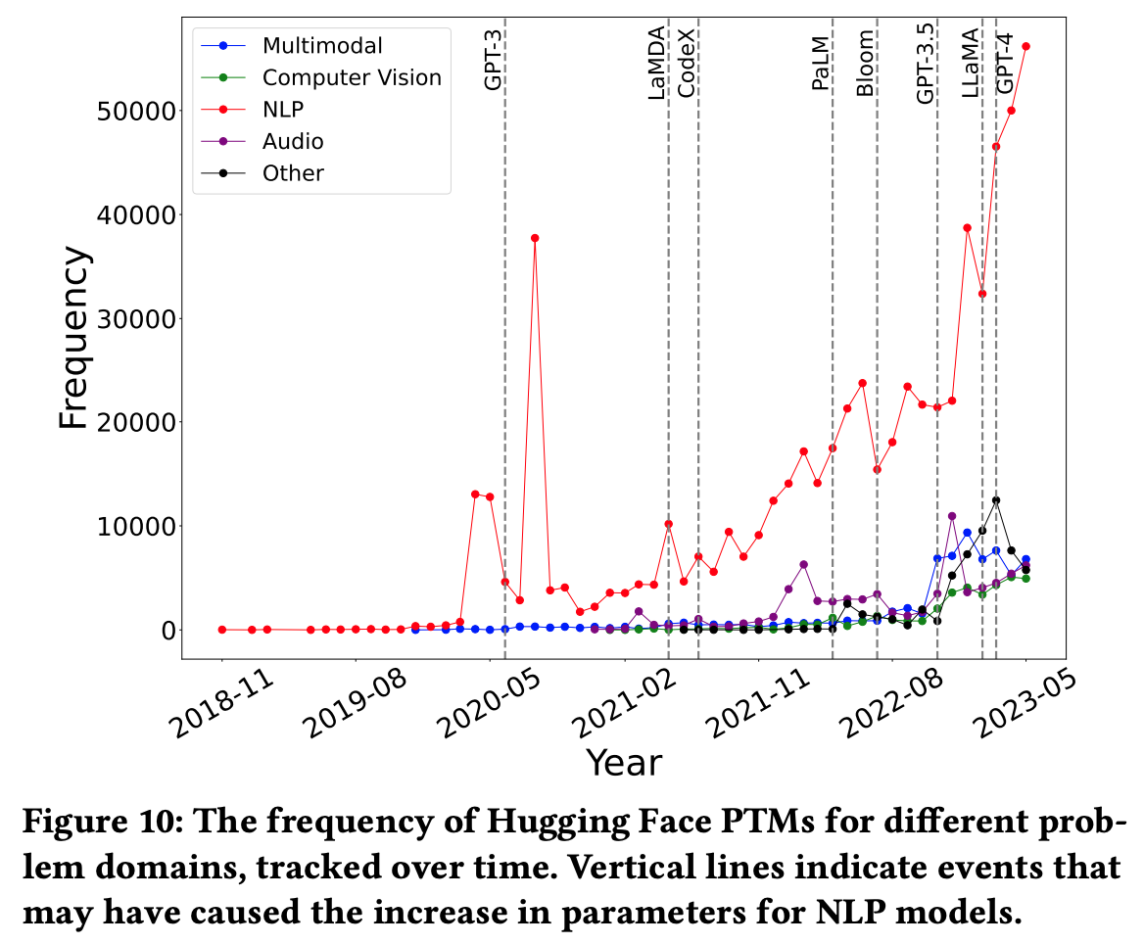
Statistics of PTM Supply Chain through Time
Notes:
Figure 10 displays the creation frequency of Hugging Face PTM packages across various problem domains over time. The data indicates a predominance of Natural Language Processing (NLP) models, likely reflecting Hugging Face’s initial focus on NLP PTMs. However, from August 2022 onward, packages for other domains have become more common. The jumps of NLP models in 2020 might relate to the rise of transformer family models during that time

Slide 29

Thinking…
Missing queryable attribute/metadata
But we have non-standardized data from model cards…
A good idea using LLM to build dataset that we are offering to ground further scientific studies on?
Notes:
Is it a good idea to use LLM as part of an MSR dataset?
a reviewer asked us this question
We provided a comprehensive evaluation by sampling multiple PTM packages from multiple problem domains which covered all attributes we captured in the database. This provides a

Slide 30
In closing…
PTM reuse is an emerging (emerged?) form of software reuse, with novel characteristics
We have only scratched the surface of PTM reuse
We must ensure its utility (for efficient software engineering), and its security (for everyone)

